Slide 1





Down Syndrome
Medical Interest
Group-USA
dsmig-usa.org
Find us on Facebook & LinkedIn

Slide 2


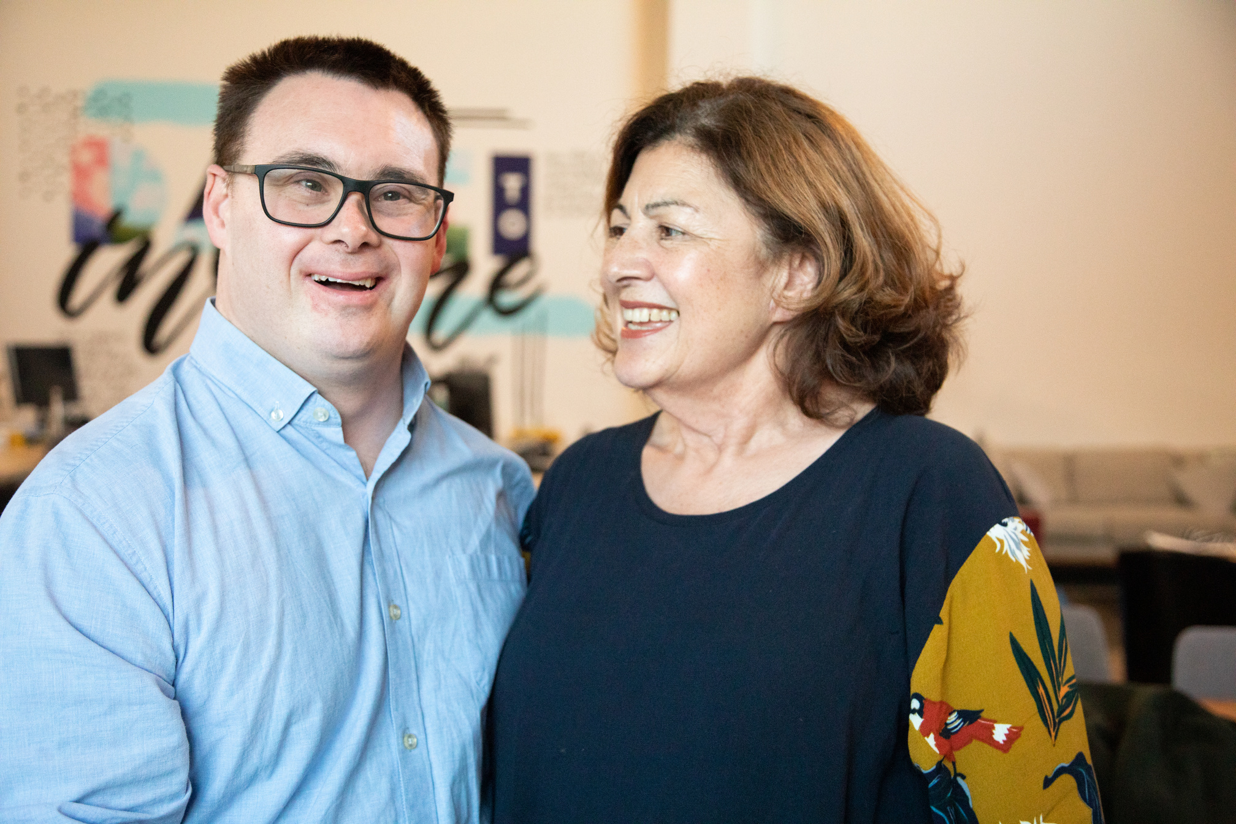

What is DSMIG-USA®?
The Down Syndrome Medical Interest Group (DSMIG-USA) is an interdisciplinary group of health professionals who serve individuals with Down syndrome (DS) and their families.
Members include physicians, scientists, nurses, clinic coordinators, therapists, social workers, health educators, psychologists, genetic counselors, students/trainees, and other professionals from across the USA and internationally.

Slide 3








Our Mission in Action
DSMIG-USA is a group of health professionals committed to promoting the optimal health care and wellness of individuals with Down syndrome across the lifespan.
Education
Networkimg
Educating professionals on the latest research and comprehensive care regarding DS and Identifying, creating, and disseminating best practices of care.
Facilitating networking among professionals caring for individuals with Down syndrome.
Mentorship
Advocacy
Mentoring the next generation of health care professionals and supporting the development of Down syndrome clinics.
Advocating for the needs and well-being of people with Down syndrome and their families through community collaborations.

Slide 4




Why join DSMIG-USA®?
  Access to a network of providers caring for children and adults with DS.
  Opportunity for expert discussion about dilemmas in clinical care via listserv.
  Up to date information on guidelines, research, DS clinics, and resources.
  Discounted Annual Symposium registration.
  Contribute to DSMIG Project ECHO, a virtual meeting for health care providers to learn and share information about the care of people with DS.
  Opportunity to serve on a Committee: Membership; Annual Symposium; Clinic Support; Marketing; Education; and/or Workgroup: Adult Healthcare; DS-ASD; Medical School Curriculum; Immune Disorders; Therapy.
317-328-4636 X161
info@dsmig-usa.org
dsmig-usa.org
3502 Woodview Trace, Ste. 300
Indianapolis, IN 46268

Slide 5
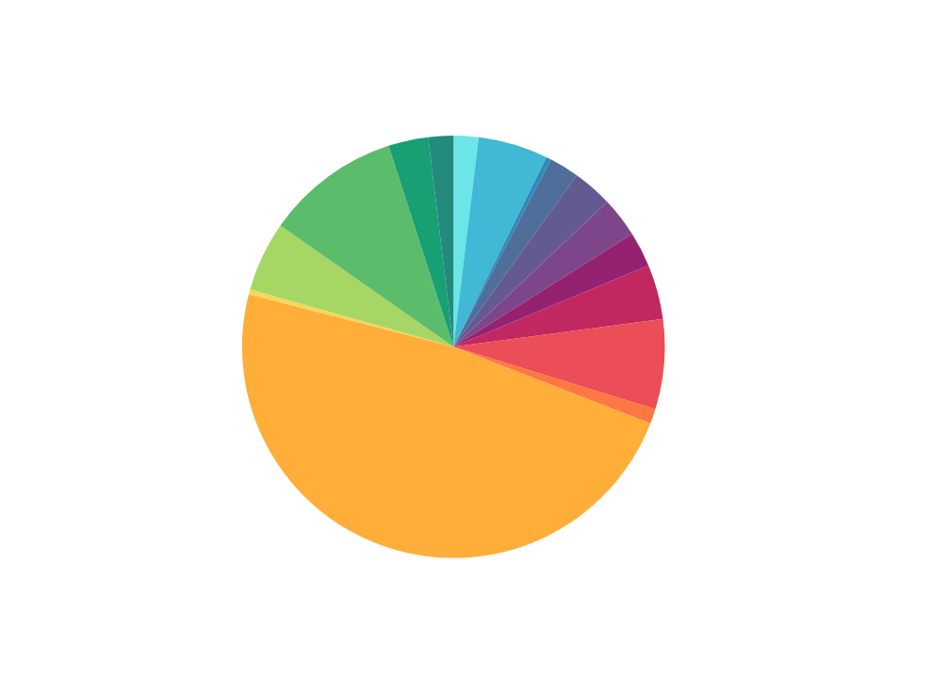
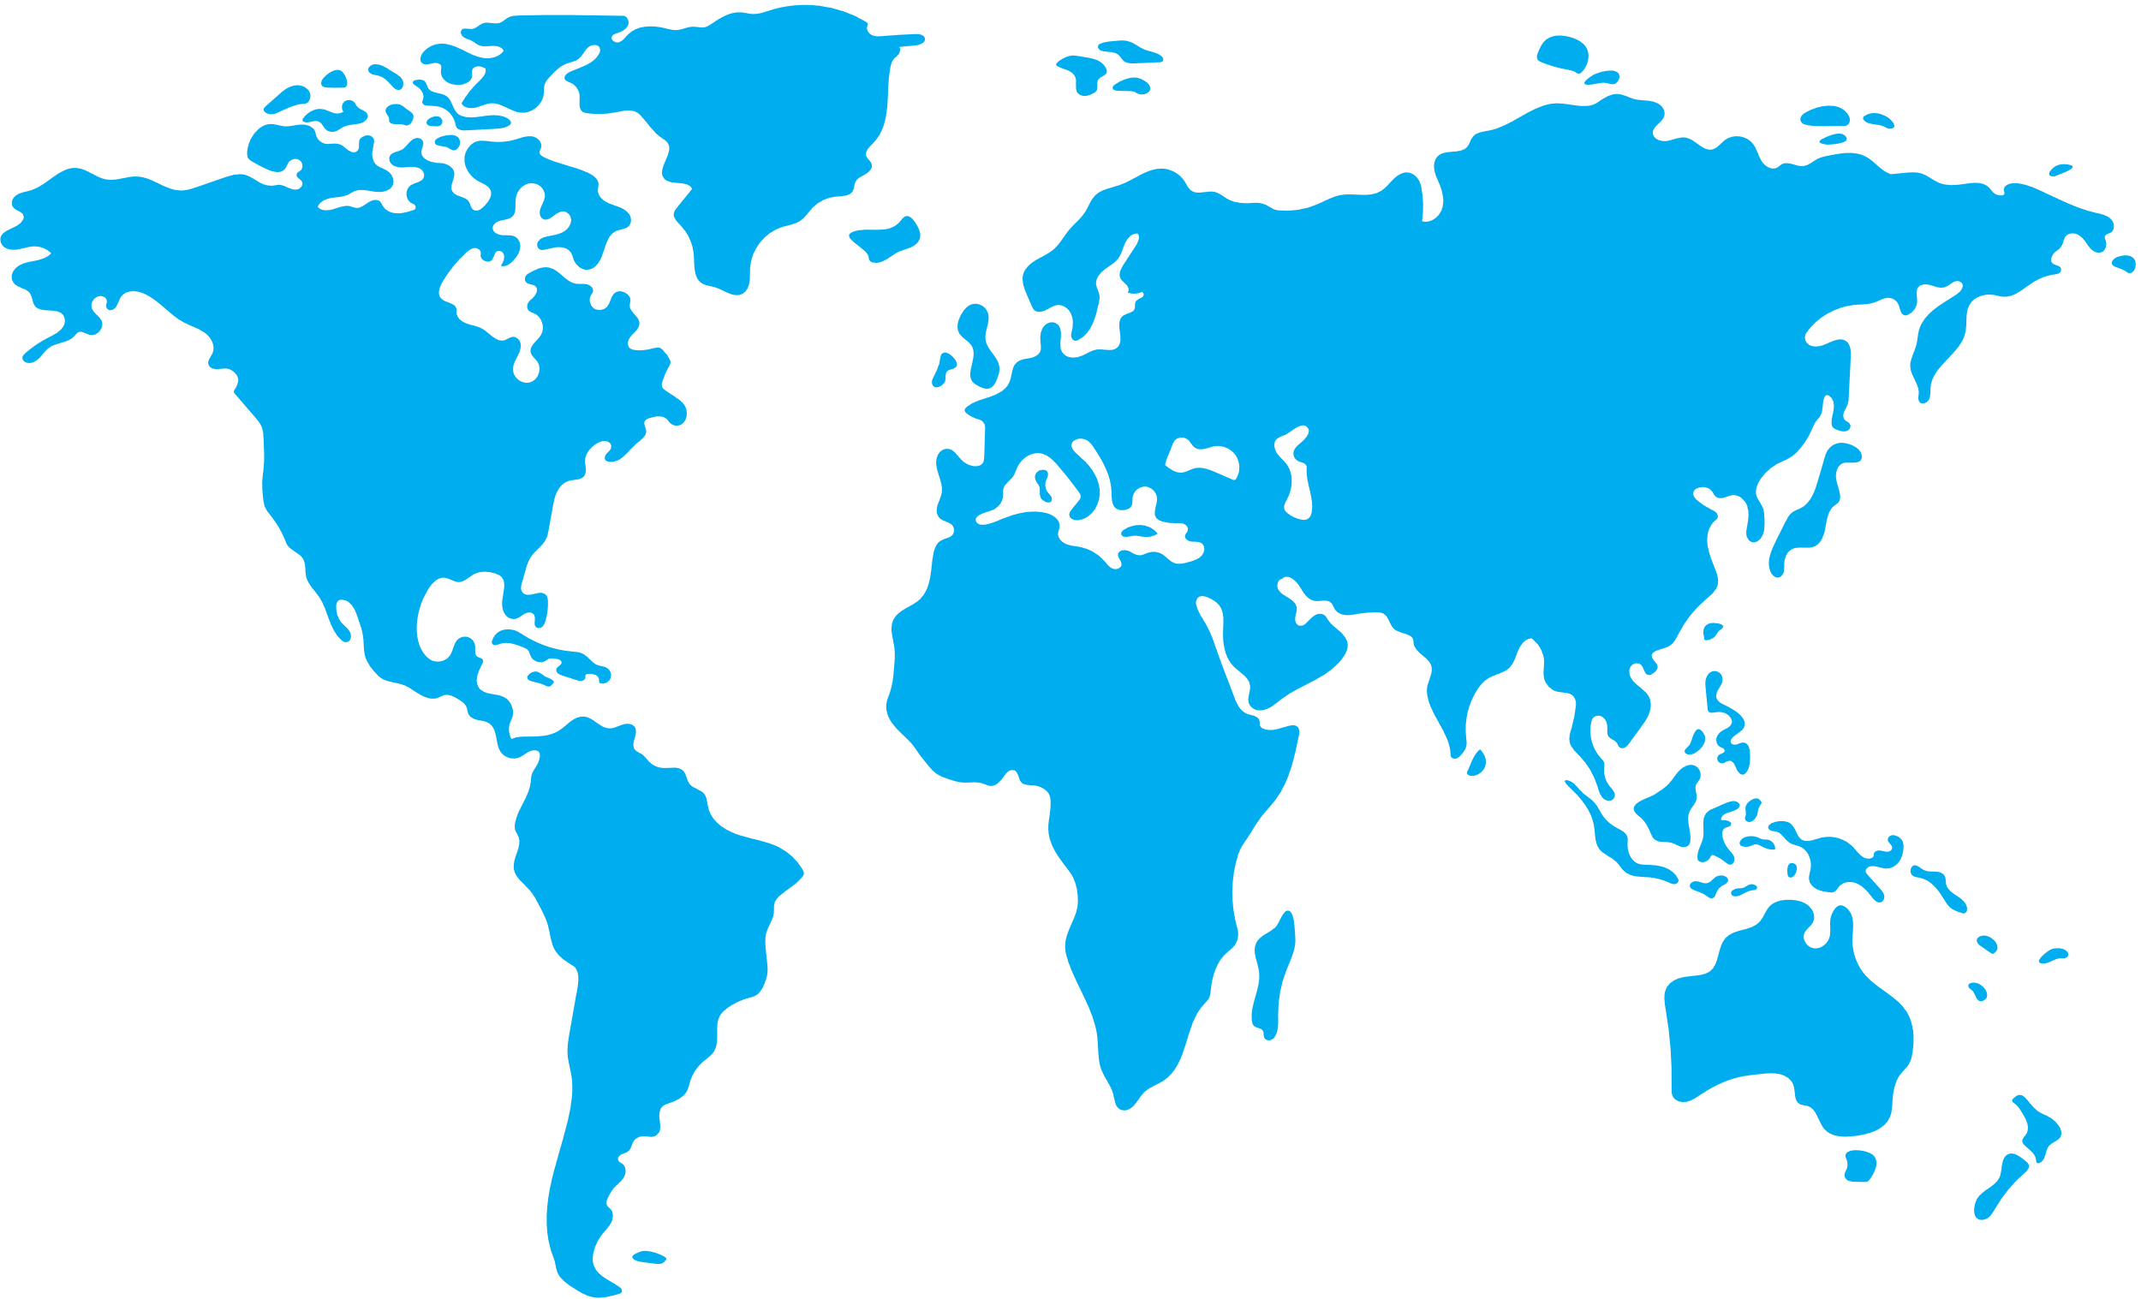











DSMIG-USA members include experts from over
16 different professions...
...and are represented in 10 countries
around the world!

Slide 6

Find out more!
317-328-4636 X161
info@dsmig-usa.org
dsmig-usa.org

